Slide 1


DETERMINANTS OF SMARTPHONE ADDICTION ON ACADEMIC PERFORMANCE OF THE STUDENTS ON DUMANJUG NATIONAL HIGH SCHOOL
JE-IN MALIG-ON
LEADER:
MEMBERS:
JHON PAUL BAONIL
WINTER DENIEGA
FRANCIS FONCEL BELACHO
ROMEO CATADMAN
GRADE 12 AQUILA

Slide 2
DETERMINANTS OF SMARTPHONE ADDICTION ON ACADEMIC PERFORMANCE OF THE STUDENTS ON DUMANJUG NATIONAL HIGH SCHOOL
LEADER:
JE-IN MALIG-ON
MEMBERS:
JHON PAUL BAONIL
ROMEO CATADMAN
FRANCIS FONCEL BELACHO
WINTER DENIEGA

Slide 3
INTRODUCTION

Slide 4
Rational of the study
This study examines the connection between student academic performance and smartphone addiction, emphasizing the rising incidence of smartphone use and the problems that come with it. About 6.3% of the world's 6.8 billion smartphone users suffer from addiction, which can cause difficulties including social isolation, diminished focus, distraction, and time management, especially among teenagers. Many students at Dumanjug National High School, particularly those in higher grades, use their smartphones excessively for social media and gaming, which has a detrimental effect on their schoolwork and general well-being. In order to develop successful treatments for encouraging responsible digital citizenship, the research attempts to pinpoint the causes of smartphone addiction and its effects on academic achievement.

Slide 5
STATEMENT OF THE PROBLEM
This study aims to investigate the determinants of smartphone addiction and its impact on academic performance among students at Dumanjug National High School.

Slide 6
STATEMENT OF THE PROBLEM
Specific Questions:
1. What is the level of smartphone addiction among the students of Dumanjug National High School?
2. What is the academic performance of the respondents in the first quarter?
3. What is the relationship between the level of smartphone addiction and academic performance?
4. What are the factors that contribute to smartphone addictions of the students?
5. What strategies or interventions can be recommended to address smartphone addiction and improve academic performance among students?

Slide 7
SCOPE AND DELIMITATION OF THE STUDY
The study aims to identify and analyze the determinants of smartphone addiction among students at Dumanjug National High School, specifically focusing on senior high school students for the 2024-2025 school year. The research will explore factors such as craving and social relationships but will not include students from other regions, educational levels, specific smartphone apps, or external factors affecting academic performance like socio-economic status or family support. The study will involve a sample of 242 randomly selected students and will not assess the long-term consequences of smartphone addiction or the effectiveness of interventions.

Slide 8
RESEARCH HYPOTHESES
The research is guided by two hypotheses: the null hypothesis (Ho) states that there is no significant relationship between smartphone addiction and academic performance among the students, while the alternate hypothesis (Ha) posits that smartphone addiction significantly influences their academic performance.

Slide 9
BACKGROUND OF THE STUDY
Smartphones have become highly sought-after gadgets, but their overuse is leading to smartphone addiction, a disorder characterized by compulsive use of mobile devices. While smartphones primarily serve as communication tools, their use often extends to social media and gaming, further contributing to addiction. Research indicates a concerning link between smartphone usage and academic achievement, particularly influenced by the nature of tasks students engage in while using these devices. Studies have identified various predictors of smartphone addiction, including daily usage patterns, social networking site addiction, impulsiveness, and physical issues like wrist pain, with significant implications for students' attention and academic performance.

Slide 10
BACKGROUND OF THE STUDY
The adverse effects of smartphone addiction extend beyond academics, impacting work-related tasks and overall mindfulness, leading to serious consequences such as accidents. In educational settings, excessive smartphone use distracts students from lessons as they often engage in web surfing, social networking, and checking messages instead of focusing on their studies. This shift in attention and time spent on smartphones hampers their academic performance, highlighting the urgent need to address this growing issue among the younger generation.

Slide 11
BACKGROUND OF THE STUDY
Although smartphones are already very popular devices, over usage of them is causing smartphone addiction, an illness marked by compulsive mobile device use. Smartphones are mostly used for communication, but they are also frequently used for social media and gaming, which can lead to addiction. Studies reveal a troubling correlation between smartphone use and academic performance, which is especially impacted by the types of activities pupils perform on these devices. Numerous indicators of smartphone addiction have been found in studies, including impulsiveness, daily usage habits, addiction to social networking sites, and physical problems like wrist pain.

Slide 12
BACKGROUND OF THE STUDY
These predictors have a big impact on students' academic performance and attention span. Beyond the classroom, smartphone addiction has detrimental effects on work-related activities and general mindfulness, which can result in accidents and other negative outcomes.

Slide 13
CONCEPTUAL FRAMEWORK OF THE STUDY
DETERMINANTS OF SMARTPHONE ADDICTION
CRAVINGS
SOCIAL RELATIONSHIPS
SOCIAL RELATIONSHIPS
SMARTPHONE ADDICTION
SMARTPHONE ADDICTION
SENIOR HIGH SCHOOL STUDENTS ACADEMIC PERFORMANCE
PROPOSED INTERVENTION PROGRAM TO MINIMIZE STUDENTS PHONE ADDICTION

Slide 14
DEFINITION OF TERMS
Academic performance - Indicates a student’s achievement after completing a course or subject from an institution. It measures student’s learning across various academic subjects, which is assessed by formative and summative assessment.
Determinants - It is an element that determines the outcome.

Slide 15
DEFINITION OF TERMS
Demographic Profile - It is the information of the respondents like gender, age, sex, etc.
Influence - The capacity to have an effect on the character, development, or behaviour of someone or something, or the effect itself.
Overuse of Smartphones - A long and uncontrollable usage of a phone for a long period of time even after trying to control one’s usage of smartphone to get the same level of individual experience previously is referred to as overuse of smartphone.

Slide 16
DEFINITION OF TERMS
Prevalence - It is the population of all the respondents.
Smartphones - A cellular telephone with an integrated computer and other features not originally associated with telephone.
Smartphone Addiction - A disorder involving compulsive overuse of mobile devices, usually quantified as the number of times users access their devices and/or the total amount of time they are online over a specified period.

Slide 17
DEFINITION OF TERMS
Student - Is a person who goes to school to learn something.
Students - A person or child who is studying in Dumanjug National High School.

Slide 18
REVIEW OF RELATED LITERATURE
Youth's growing access to smartphones has sparked worries about smartphone addiction, which is characterized as obsessive or excessive use that interferes with day-to-day functioning, especially scholastic achievement. Despite the paucity of study, smartphone addiction is acknowledged as a behavioral addiction that is comparable to internet addiction. Although its primary use is communication, smartphones may now be used for texting, emailing, gaming, and internet access. There are discussions over whether smartphone addiction is a separate behavioral problem as a result of this widespread use becoming the social norm. According to some research, smartphones can help students study, but they can also make learning more difficult. Uncontrollable use, restlessness, and withdrawal symptoms like anxiety and insomnia when cut off from the gadget are all signs of addiction.

Slide 19
REVIEW OF RELATED LITERATURE
Determinants of smartphone addiction Several psychological, social, and technological factors contribute to the development of smartphone addiction.

Slide 20
REVIEW OF RELATED LITERATURE
Psychological Determinants
• Personality Traits
• Anxiety & Stress
• Social Anxiety

Slide 21
CHAPTER 3
RESEARCH DESIGN
This study used a correlational research design to examine the relationship between smartphone addiction and academic performance among students.

Slide 22
CHAPTER 3
RESEARCH ENVIRONMENT
A study was carried out at the public Dumanjug National High School in Li-ong, Dumanjug, Cebu, which is close to the Dumanjug Extension of Cebu Technological University. The school employs 62 people, including the principal and instructors, and has about 2000 students. Improving student learning is its goal.

Slide 23
CHAPTER 3
SAMPLE AND POPULATION
With a margin of error of 0.05, the sample size of 242 students was determined using Slovin's calculation based on a population of 615 (340 grade 11 and 275 grade 12 students). Squaring the margin of error (0.0025), multiplying it by the population size (1.5575), adding 1 to this result (2.5575), and then dividing the population size by this total (615 ÷ 2.5575 = 242) were the steps involved in the computations.

Slide 24
CHAPTER 3
RESEARCH INSTRUMENT
Senior high school students (grades 11 and 12) were surveyed using a Likert scale questionnaire (Strongly Disagree to Strongly Agree). Four items on craving, five on smartphone addiction, and four on social ties were all included in the survey.

Slide 25
CHAPTER 3
DATA COLLECTION
In order to maximize response rates and enable prompt question clarification, data was gathered through in-person surveys of senior high school students at Dumanjug National High School. In order to examine possible relationships and make conclusions, the questionnaires looked at demographic characteristics (age, gender, and academic achievement), social influences, psychological well-being, perceived advantages and disadvantages, and smartphone usage patterns.

Slide 26
STATISTICAL TREATMENT OF THE DATA
To determine if there is no significant relation between determinants of smartphone addiction and academic performance of the Students we used Pearson’s r correlation.

Slide 27
STATISTICAL TREATMENT OF THE DATA
The table below indicates the data treatment for determinants of Smartphone Addiction.
RANGE | DESCRIPTION | INTERPRETATION
4.2 – 5.0 | Strongly Agree | Strongly Addicted
3.4 – 4.1 | Disagree | Moderately Addicted
2.6 – 3.3 | Neutral | Neutral
1.8 – 2.5 | Agree | Slightly Addicted
1.0 – 1.7 | Strongly Disagree | Not Addicted

Slide 28
STATISTICAL TREATMENT OF THE DATA
On the other hand, the academic performance will be interpreted below:
RANGE | INTERPRETATION
90 – 100 | Outstanding
85 – 89 | Very Satisfactory
80 – 84 | Satisfactory
75 – 79 | Fairly Satisfactory
Below 75 | Not Addicted

Slide 29
DATA PRESENTATION, ANALYSIS, AND INTERPRETATION
CHAPTER 4

Slide 30
CHAPTER 4
DATA PRESENTATION, ANALYSIS, AND INTERPRETATION

Slide 31
CHAPTER 4
DATA PRESENTATION, ANALYSIS, AND INTERPRETATION
Table 1: The Determinants of Smartphone addiction of the Respondents.

Slide 32
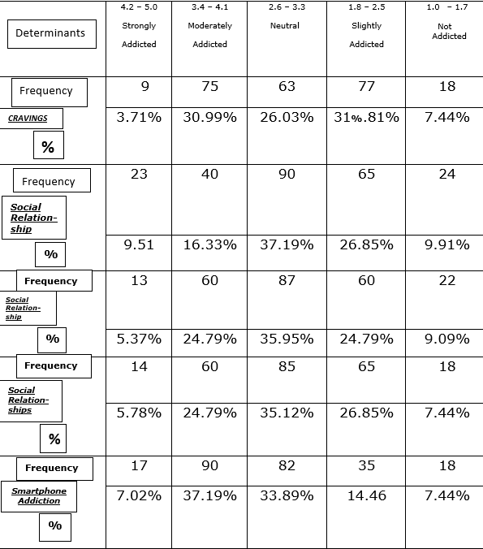
CHAPTER 4
DATA PRESENTATION, ANALYSIS, AND INTERPRETATION

Slide 33
CHAPTER 4
DATA PRESENTATION, ANALYSIS, AND INTERPRETATION
A five-point scale (highly addicted to not addicted) was used in a study to assess addiction levels across five categories, such as cravings, social relationships, and smartphone addiction. In the "moderately addicted" group, smartphone addiction had the highest proportion (3719%; this was probably a typographical error; it should have been 37.19%). This implies that a sizable percentage of participants engaged in moderately problematic smartphone use. Although some studies divide smartphone use into several behavioral categories (dependent, habitual, etc.), it's crucial to remember that excessive use isn't always bad; in fact, it may even lessen other bad habits.

Slide 34
CHAPTER 4
DATA PRESENTATION, ANALYSIS, AND INTERPRETATION
TABLE 2: The Academic Performance of the Respondents

Slide 35
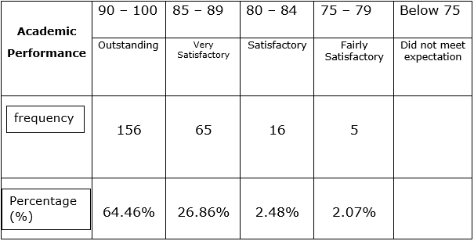
CHAPTER 4
DATA PRESENTATION, ANALYSIS, AND INTERPRETATION

Slide 36
CHAPTER 4
DATA PRESENTATION, ANALYSIS, AND INTERPRETATION
A grading scheme with percentage ranges (90–100%, 80–89%, etc.) and the frequency of pupils earning each grade are shown in Table 2. Promising students prioritize their studies over social media and games, and some may even forsake their smartphones for school-related reasons. They also tend to be less addicted to smartphones. Untranslated labels in the table, however, prevent a thorough interpretation and a thorough comprehension of the qualitative descriptions connected to each grade range. The table's overall usefulness is limited by its incompleteness.

Slide 37
CHAPTER 4
DATA PRESENTATION, ANALYSIS, AND INTERPRETATION
Table 3: Summary of Students Smartphone Addiction

Slide 38
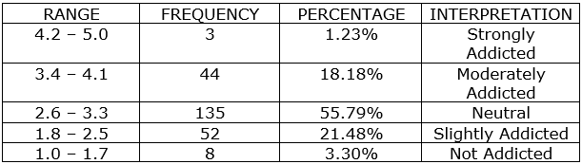
CHAPTER 4
DATA PRESENTATION, ANALYSIS, AND INTERPRETATION

Slide 39
CHAPTER 4
DATA PRESENTATION, ANALYSIS, AND INTERPRETATION
According to a survey, the majority of participants (55.79%) were classified as "Neutral" in terms of smartphone addiction, indicating a modest degree of problematic use. Lesser proportions were categorized as "Moderately Addicted," "Strongly Addicted," and "Slightly Addicted." This underscores the necessity of initiatives to encourage good digital behaviors and possibly enhance academic achievement. Despite being a societal norm, the ubiquitous use of smartphones raises questions about possible health consequences and the ongoing debate over whether smartphone addiction is a separate behavioral disorder. Research on smartphones' effects on schooling reveals differing opinions, with some pointing to possible drawbacks and others pointing out advantages.

Slide 40
CHAPTER 4
DATA PRESENTATION, ANALYSIS, AND INTERPRETATION
Table 4: The correlation analysis between Academic performance and Smartphone Addiction.

Slide 41
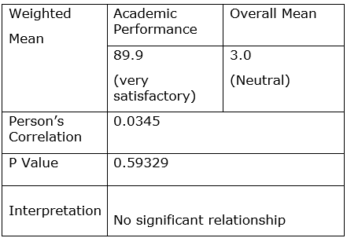
CHAPTER 4
DATA PRESENTATION, ANALYSIS, AND INTERPRETATION

Slide 42
CHAPTER 4
DATA PRESENTATION, ANALYSIS, AND INTERPRETATION
Academic performance and smartphone addiction were found to be weakly positively correlated (r = 0.0345, p = 0.59329) by correlation analysis. This correlation is not statistically significant, according to the high p-value. Even while overall and weighted mean academic scores have a little positive correlation, more investigation is required to identify other factors affecting academic achievement.

Slide 43
CHAPTER 5

Slide 44
CHAPTER 5
SUMMARY OF FINDINGS AND CONCLUSION

Slide 45
CHAPTER 5
SUMMARY OF FINDINGS
A study on smartphone addiction and academic achievement at Dumanjug National High School is summarized in this chapter. Even if a sizable portion of students suffer from moderate smartphone addiction, there is no discernible link between academic achievement and addiction levels, according to a correlation analysis. Limiting smartphone use may be the reason for the strong academic achievement (weighted mean of 89.9). Social pressure, mental health issues, a lack of alternative coping strategies, and ignorance are risk factors for smartphone addiction. Time management, goal-setting, active learning strategies, productive study habits, and reducing distractions are all ways to boost academic achievement.

Slide 46
CHAPTER 5
CONCLUSION
Even though a sizable portion of pupils (37.19%) had moderate smartphone addiction, the results from Dumanjug National High School in Chapter 4 do not demonstrate a significant correlation between smartphone addiction and academic performance (Table 1). Although there was a slight positive connection, it is statistically insignificant due to the high p-value. The intricate connection between smartphone addiction and academic achievement requires more investigation, taking into account other influencing elements.

Slide 47
CHAPTER 5
RECOMMENDATIONS
We can recommend several tips to help students avoid smartphone addiction:

Slide 48
CHAPTER 5
RECOMMENDATIONS
Set limits: Establish specific time periods during the day when you use your phone, and stick to those limits
Create a schedule: Plan your day in advance and allocate time for studying, socializing, exercising, and other activities that don't involve your phone.

Slide 49
CHAPTER 5
RECOMMENDATIONS
3. Use app blockers Consider using apps or features that limit your access to certain apps or websites that may be contributing to your smartphone addiction.

Slide 50
CHAPTER 5
RECOMMENDATIONS
4. Practice mindfulness: Be aware of your phone usage and how it affects your mood, productivity, and relationships. Take breaks and practice mindfulness techniques to stay present and focused.

Slide 51
CHAPTER 5
RECOMMENDATIONS
5. Find alternative activities: Replace phone usage with other activities you enjoy. such as reading a book, going for a walk, or having a conversation with a friend.

